Slide 1
Notification Hubs Deep Dive
Elio Damaggio | Program Manager, Windows Azure Notification Hubs
Miranda Luna | Product Manager, Windows Azure Mobile Workload

Slide 2
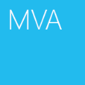

Agenda
Notification Hubs Deep Dive
01 | Overview
02 | App Registration
03 | Device Registration
04 | Sending a Push Notification
05 | Location-Based Push
06 | Best Practices & Resources

Slide 3
Setting Expectations
Target Audience
Developers building mobile applications for the Windows, iOS and/or Android platforms
Developers looking to add powerful and personalized push notifications to existing mobile apps
Suggested Prerequisites/Supporting Material
Introduction to Notification Hubs
Broadcasting Alerts
Filtering Alerts

Slide 4
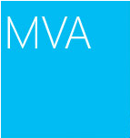
Join the MVA Community!
Microsoft Virtual Academy
Free online learning tailored for IT Pros and Developers
Over 1M registered users
Up-to-date, relevant training on variety of Microsoft products
“Earn while you learn!”
Get 50 MVA Points for this event!
Visit http://aka.ms/MVA-Voucher
Enter this code: MobilAz (expires 3/3/2014)

Slide 5
01 | Overview

Slide 6
Mobile Backends in Azure
Degree of Customizability
Speed of Development & Ease of Maintenance

Slide 7
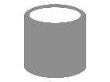
Hooks into any app backend
On-Premises Backend
Windows Azure Backend
Logic
Data
Identity

Slide 8
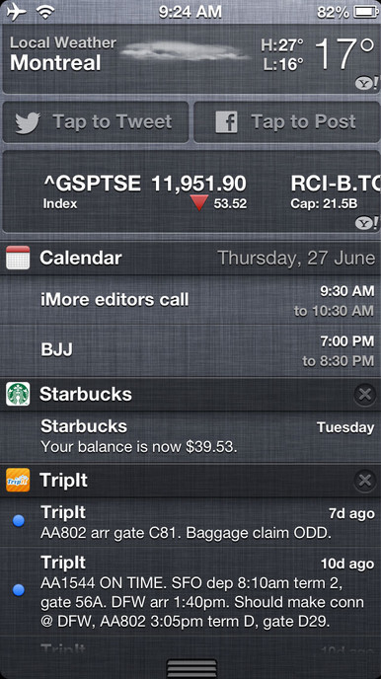
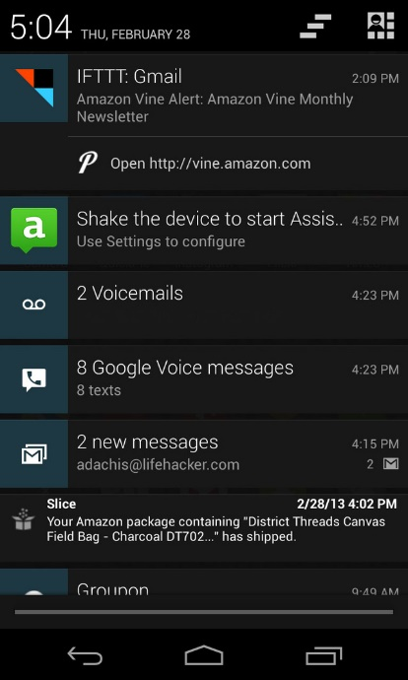
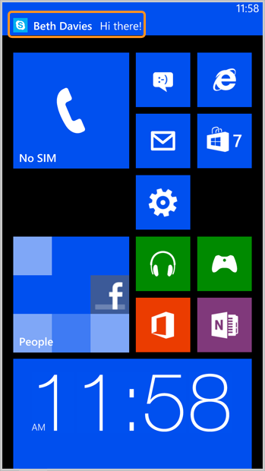
Mobile Push Notifications
Essential in consumer and enterprise apps
For consumer apps:
Richer than SMS, 10000s times cheaper
For enterprise apps:
Keep users up to date with the business
Not only for alerts/toasts/tiles
‘push to sync’ notifications

Slide 9
On-Premises
Major Media Publisher
Virtual Machines
Webzen
Cloud Services
VMob
Web Sites
Mural.ly
Mobile Services
OzPostcards

Slide 10
Push Notification Challenges
While there are significant benefits to using push notifications in a mobile app, rolling your own push infrastructure is extremely difficult in terms of implementing a system capable of:
Cross-Platform Push Notifications
Each push service (APNS for iOS, GCM for Android, WNS for Windows, etc.) has different protocols (e.g., HTTP vs. TCP, xml payload vs. JSON payload)
Targeting on the server-side based on interest and location
Segmenting users based on interest tags and routing only the most relevant content to each segment
Personalizing notifications on the client-side based on language, currency, device, etc.
Each device displays notifications differently
High-Volume with Low Latency
Limited by the capability of each VM so need to spin up scores of VMs and shard your application in order to serve a large user base
Maintaining and accurate device handle registry
Adding registrations upon installation, updating tags, pruning upon rejection from push notification service (uninstall)

Slide 11
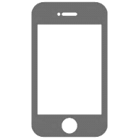
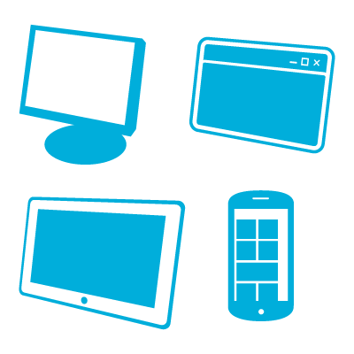
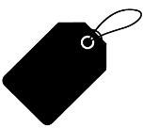
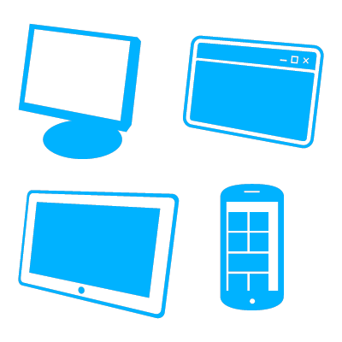
Notification Hubs Overview
“female” “New York” “chocolate”
$
¥
“male” “New York” “vanilla”
APNS
€
“female” “Seattle” “vanilla”
¥
“female” “vanilla”
GCM
“female” “Seattle” “vanilla”
App back-end
€
Notification Hub
$
“male” “Seattle” “vanilla”
tag = “female”
MPNS
£
“female” “Seattle” “vanilla”
tag = “Seattle”
$
“female” “Seattle” “vanilla”
tag = “vanilla”
WNS

Slide 12
02 | App Registration

Slide 13
Registering a Windows Store app

Slide 14
Register an iOS app
(void)application:(UIApplication *)application didRegisterForRemoteNotificationsWithDeviceToken:(NSData *) deviceToken {
…
SBNotificationHub* hub = [[SBNotificationHub alloc] initWithConnectionString:
@"<connection string>" notificationHubPath:@"mynh"];
[hub registerNativeWithDeviceToken:deviceToken tags:nil completion:^(NSError* error) {
if (error != nil) {
NSLog(@"Error registering for notifications: %@", error);
}
}];
}

Slide 15
Register an Android app
In your main activity:
Notification Hub hub = new NotificationHub("<hub name>", "<connection string>", context);
GoogleCloudMessaging gcm = GoogleCloudMessaging.getInstance(context);
String regid = gcm.register(SENDER_ID);
NativeRegistration r = hub.register(regid);

Slide 16
Register a Windows Store app
var hub = new NotificationHub(“<hub name>", "<connection string>");
var channel = await PushNotificationChannelManager.CreatePushNotificationChannelForApplicationAsync();
await hub.RegisterNativeAsync(channel.Uri);

Slide 17
03 | Device Registration

Slide 18
Templates for cross-platform push
<toast>
<visual>
<binding template=\"ToastText01\">
<text id=\"1\">$(message)</text>
</binding>
</visual>
</toast>
Registration
Client apps can register with a platform specific template, e.g.,
Alice’s Surface registers with Windows Store ToastText01 template.
Bob’s iPhone with the Apple JSON template: { aps: {alert: “$(message)”}}
Send Notification
App back-end sends a platform independent message: {message: “Hello!”}
Version Independence
Templates can be used to abstract different client app versions.
Hello!
{ message: “Hello!” }
Notification Hub
App back-end
{
aps: {
alert: “$(message)”
}
}
Hello!

Slide 19
Templates for personalization
<toast>
<visual>
<binding template=\"ToastText01\">
<text id=\"1\">$(tempF)</text>
</binding>
</visual>
</toast>
Registration
Client apps can register with personalized templates, e.g.,
Alice’s Surface wants to receive weather information in F degrees.
Bob’s iPhone wants weather information in C degrees.
Send notification.
App back-end sends a message including both temperatures: {tempC: “23”, tempF: “73”}.
Template Expressions.
Template support a simple expression language:
E.g., {‘Sam, ’+$(friend)+’ added you to ’+$(groupName)+‘ group’}.
16
{tempC: “23”, tempF: “73”}
Notification Hub
App back-end
{
aps: {
alert: “$(tempC)”
}
}
61

Slide 20
Cross-platform templates and tags

Slide 21
04 | Sending a Push Notification

Slide 22
Notify a single logical user
App back-end
Tags can be used to represent individual logical users
Client app authenticates with the app backend
Devices pass device handle to the app backend
App backend registers the devices for the tag “userId”
Target individual users by specifying particular “userId” tag
App back-end
Notification Hub
Tag: ”00568282”
Tag: ”00430924”

Slide 23
Broadcast to a segment based on interest
Tags as interest groups
Client app can register with a set of interest tags.
Tags are simple strings (no pre-provisioning is required)
App backend can target all clients with the same tag in a single API call
Tag Expressions allow you to segment any subset of interest tags that can be expressed using Boolean expressions
Users tagged for Rolling Stones AND Beatles (band:RollingStones && band:Beatles)
Users tagged for either Rolling Stones or Beatles (band:RollingStones || band:Beatles)
Users tagged for Rolling Stones but not also Beatles (band:RollingStones && !band:Beatles
Users tagged for Rolling Stones or Beatles in Seattle
((band:Rolling Stones || band:Beatles) && loc:Seattle)
App back-end
App back-end
Tag: ”Beatles”
Notification Hub
Tag: ”RollingStones”
Tag: ”Beatles”

Slide 24
Notify all users
App back-end
Broadcast a notification to all users by making a single API from your app backend w/o specifying any tags
Notification Hub
App back-end

Slide 25
Notify all users, in batches
App back-end
Tags can be used to represent groups of users for sending notifications to all users in batches
Client app authenticates with the app backend
Devices pass device handle to the app backend
App backend registers the devices for the tag “batchNo”
Target batches in sequence by specifying particular “batchNo” tags in sequential API calls
App back-end
Notification Hub
Tag: ”Batch1”
Tag: ”Batch4”
Tag: ”Batch4”

Slide 26
05 | Location-Based Push

Slide 27
Geo-Targeting
High (<1 min)
Contextual reminders
Weather alerts
Temporal Accuracy
Retarget customers of a specific store
Low (>24 hrs)
Send coupons by region
Low (>10 mi)
High (<500 ft)
Geographical Accuracy

Slide 28
Tags for Location-Based Push
Use platform specific geolocation APIs
Use reverse geocoding service (Bing, Google, …)
Encode location in a tag and register
Send notification to tag
Watch this video for a detailed overview
Geocoding Services
App back-end
“Zip:98052”
“Zip:98052”
Notification Hub

Slide 29
06 | Best Practices & Resources

Slide 30
Best Practices
Use tags to define batches of devices
Tags to define logical users/groups of users that you want to receive different message content
Templates for personalization/localization of the same message content
Use SignalR and Service Bus to extend push capabilities to support enterprise scenarios like deliver acknowledgement, end-to-end encryption, audit, etc.

Slide 31
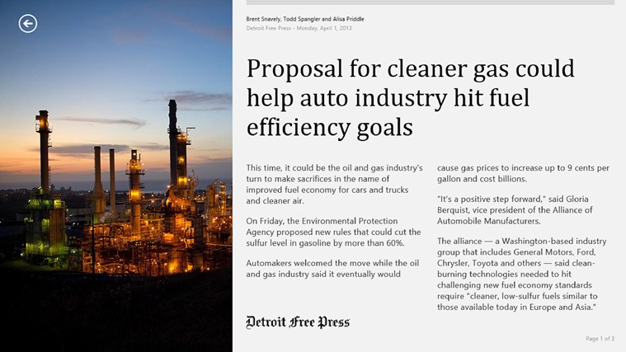
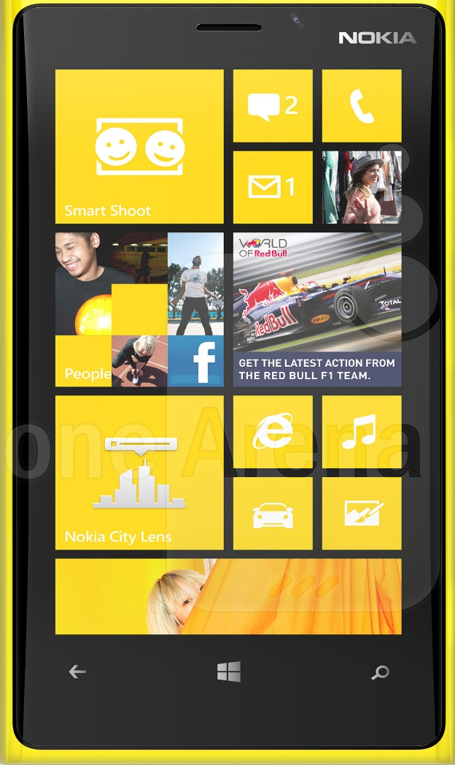
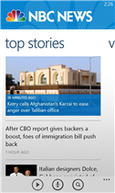
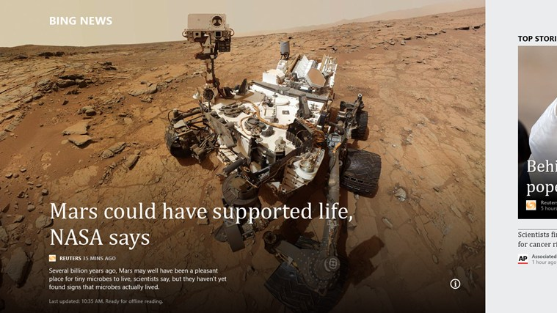

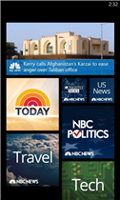

Slide 32

Notification Hubs Resources
Windows Azure Mobile Services Overview, Tutorials and Resources
Azure Documentation Center
MSDN Documenation
Android (tutorial)
iOS (tutorial)
Windows Store (tutorial)
Windows Phone (tutorial)
Learn/Channel 9 Introduction | iOS | Windows Store | Tags and Templates
REST API Reference
http://msdn.microsoft.com/en-us/library/windowsazure/jj710108.aspx
Windows Azure Pricing http://www.windowsazure.com/en-us/pricing/details/notification-hubs/
Microsoft Azure Certified Training http://www.microsoft.com/learning/en/us/training/azure.aspx

